Slide 1
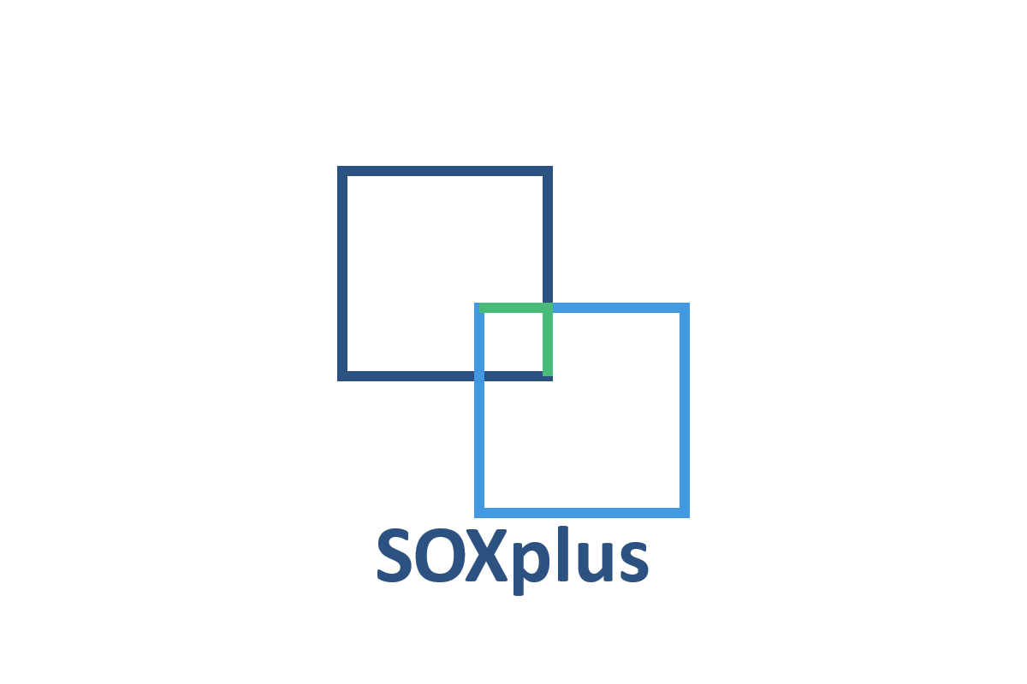
Transform SOX Audits 50% Faster 50% Less Cost

Slide 2
Market need
SOX Compliance
Two Phases
MUST for US-listed companies
Pre-IPO onwards
Annual
Recurring
Pre-Audit: Getting audit-ready.
Audit: External auditors verify and sign-off
SOXplus focuses on Pre-audit

Slide 3
The Problem
Time
Approach
Significant time, effort, and coordination: 6-9 months minimum
Manual: 1:1 interviews, note-taking, transcription
Tools are incomplete, ignore pre-audit and serve as document repositories
SOXplus leverages AI to make pre-audit faster and cheaper
Cost
Smaller companies spend >$200,000 and dedicating months to the process.
Larger companies spend millions annually

Slide 4
The Impact
Time
Cost
6-9 months
reduce to
2-5 months
$200,000+
reduce to
$50,000+

Slide 5
Our Solution
AI-driven Walkthroughs
AI-aided Deliverables
Human Expert Oversight
Dynamic Q&A sessions
Gather richer, more accurate data
Engaging and effective interfaces
SOX narratives
Risk heat maps
Assertion tables
SOD analyses
Control lists
Risk and recommendations table
Process flowcharts
Expert human attached to engagement
Backed by onsite and offsite human team members
Ensure precision, round-the-clock progress, and audit-ready outputs.
Early hook: coso-based entity-wide controls scorecard

Slide 6
Market Opportunity
Market Gap
Existential Need
No one addressing pre-audit
Opportunity to dominate small to medium size market with cost-time messaging
Current tools don’t address pre-audit; SOXplus could be it
MUST for US-listed companies
Pre-IPO onwards
Annual
Recurring

Slide 7
Market SIZE
SOX Compliance
Initial Target
The Long Tail and the Spin-offs
US Audit services market (incl. SOX compliance) is ~$55.3 billion (2025)
Companies budget $1–$2 million annually for SOX compliance
Smaller firms face higher costs due to fewer economies of scale, with pre-compliance expenses averaging $1+ million
Pre-audit preparation (internal controls documentation, risk assessments, etc.) consume 70% of SOX compliance hours
844–3,313 smaller public companies plus S1 filers
Cost Savings: Reducing costs from $200,000+ to $50,000–$100,000 per engagement
Revenue Potential: With market penetration, revenues can rapidly march to $50+ million per year
Ongoing SOX compliance
Expand into Internal Audit and risk management
Target the larger enterprises
Productize
Repurposing components to address:
Fraud detection
Other enterprise workflows

Slide 8
WE ARE LOOKING FOR a visionary partner
What we can bring
What’s needed
Together we bring
Aruna – CPA, CIA, CFE
Physically in Florida
Expert in the domain
Define and drive development, delivery
Can bring on Ashok, MBA, for Business Development
Platform development and scaling
Market entry and expansion
Strategic partnership development
Services-tied SOXplus can dramatically drive revenues in the US market
Synergistic customer base: One connect, multiple upsides

Slide 9
Let Us dominate SOX pre-Audits 50% Faster 50% Less Cost
First comprehensive AI solution for pre-audit phase
Proven cost and time savings
Combined AI/human expertise approach
Scalable technology platform

